Slide 1

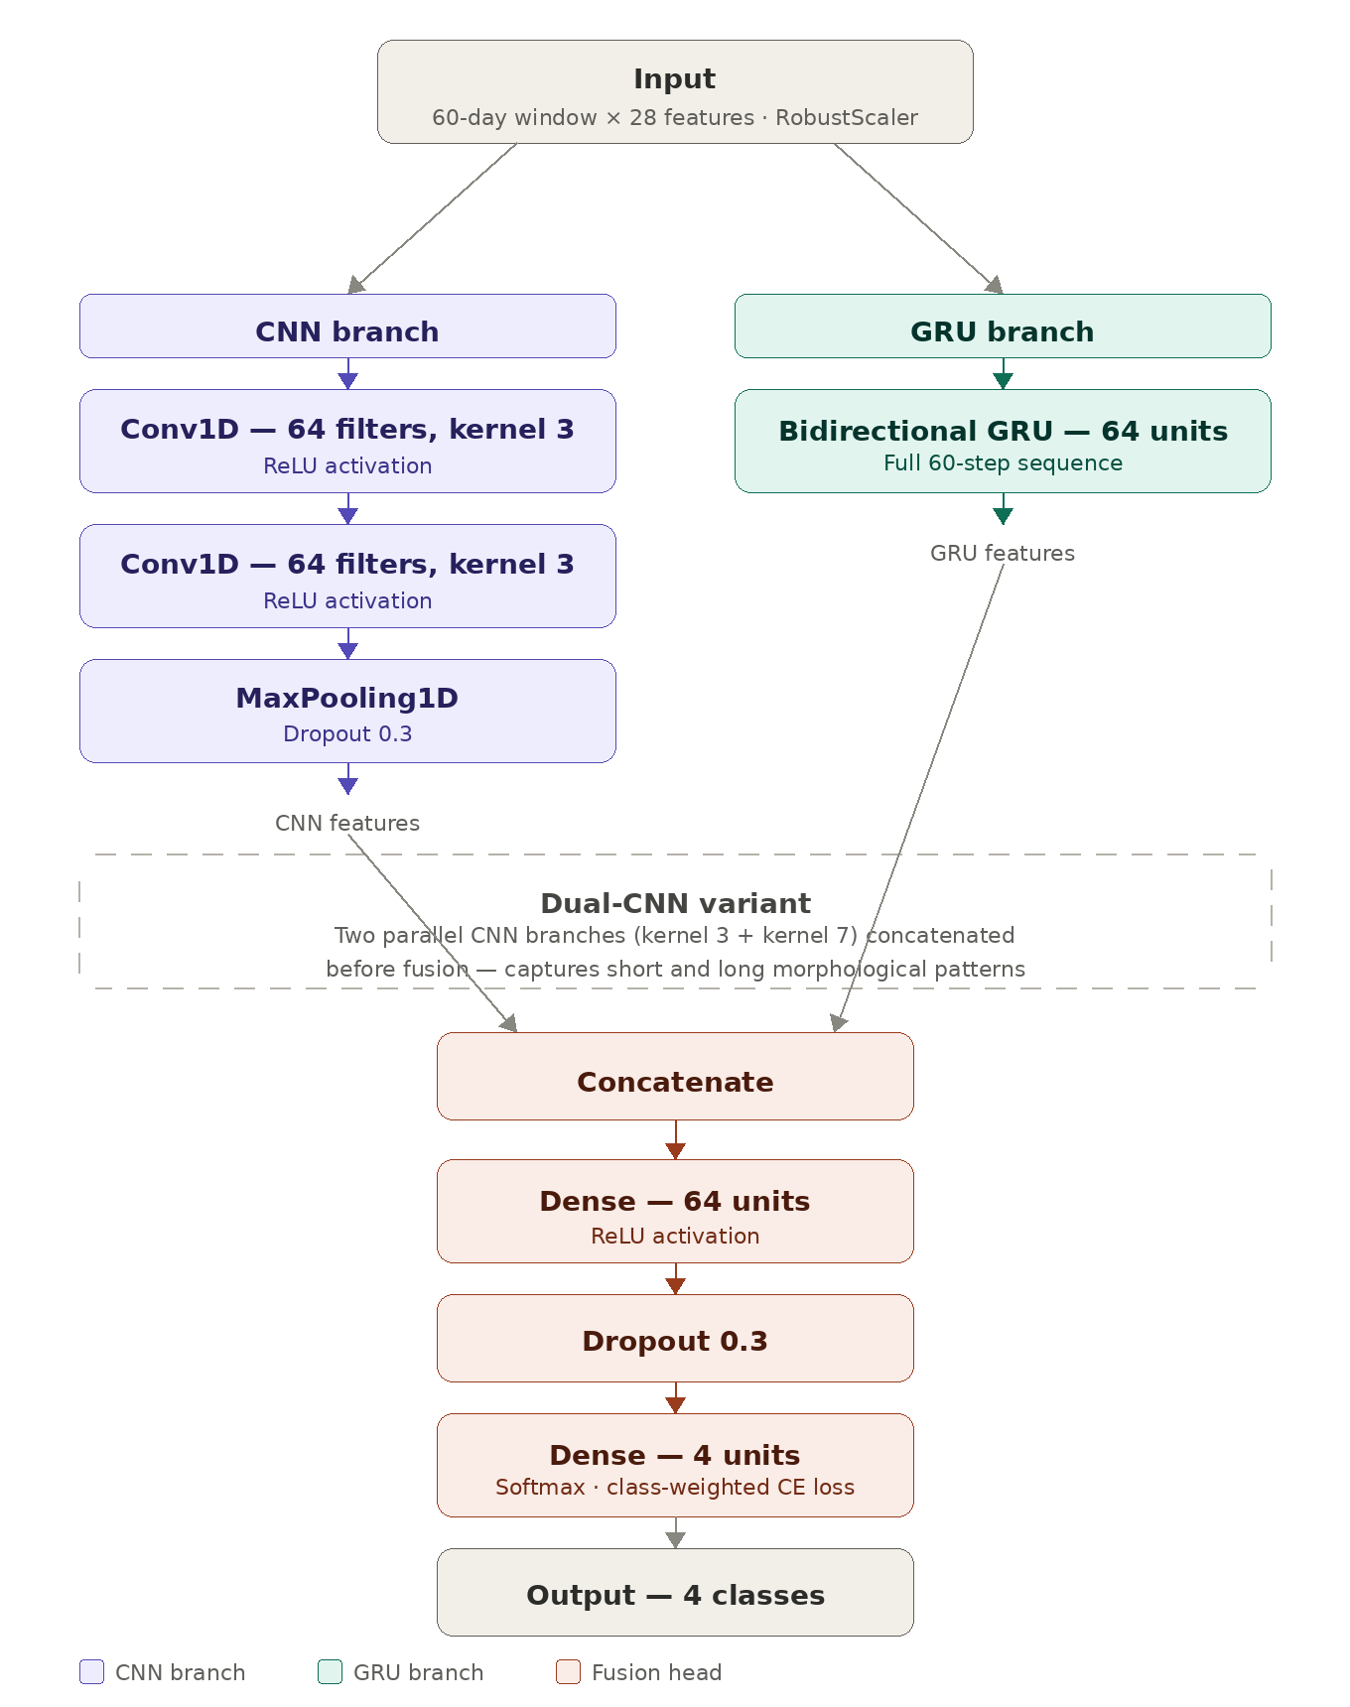
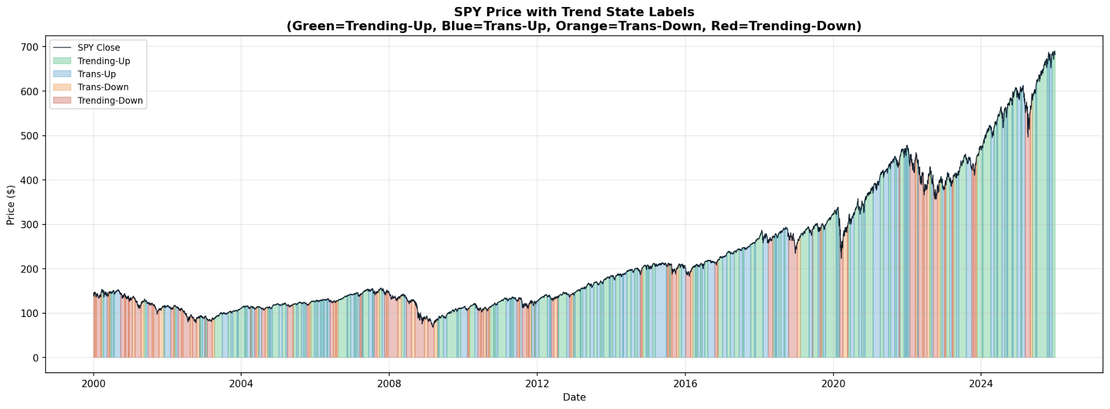
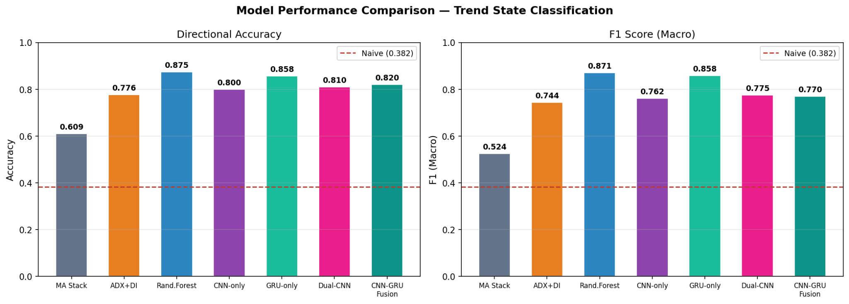
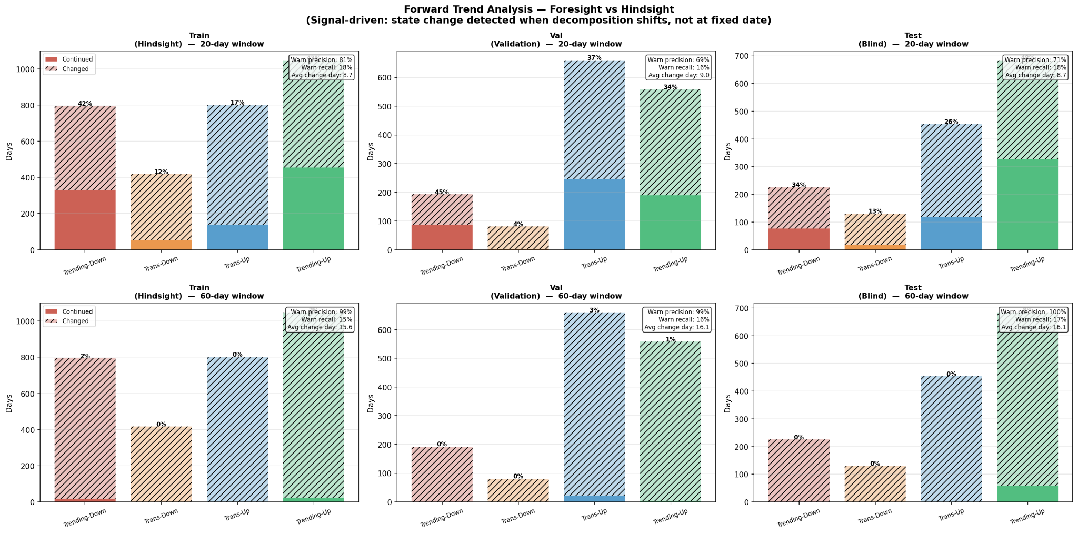
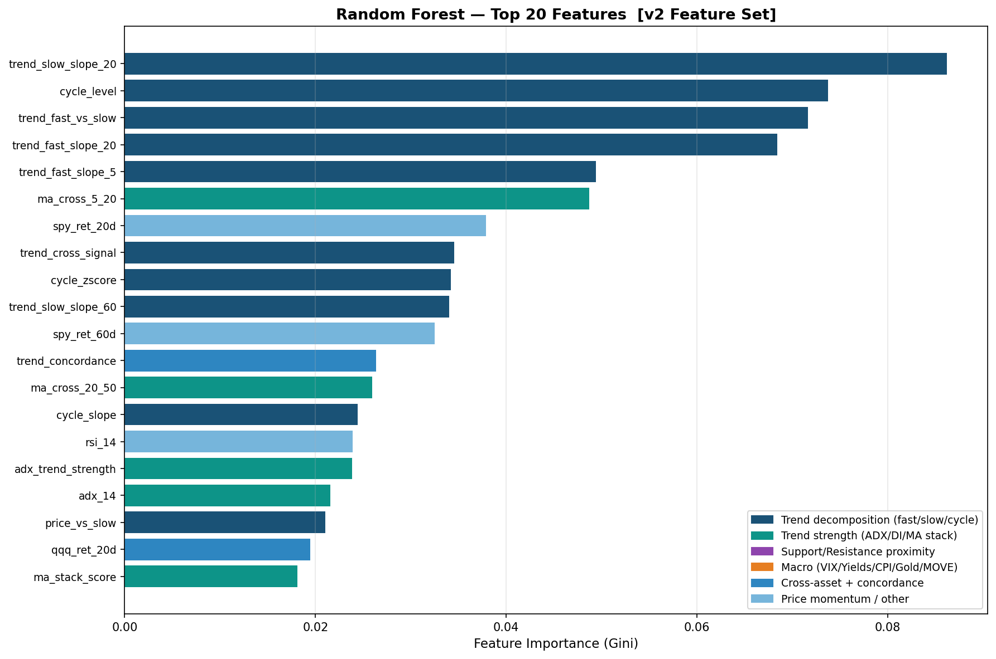
AI Student Symposium 2026
Course ID: ECE525
NNDL.85 \ ID.52
Low-Frequency Signal Decomposition for Equity Trend Analysis Using CNN-RNN Fusion
PROBLEM STATEMENT
This project treats the equity price series as a signal-processing problem. By decomposing market signals into structural components trend, cycle, and noise we classify the current market regime with strict causality across four states: Trending-Up, Trans-Up, Trans-Down, and Trending-Down.
Cheng-Hao Chiu, Pushkar Patil, Zhitian Deng/NNDL.85
Network Architecture
Input: 60-day lookback window × 28 features. RobustScaler normalized on training data only.
CNN Branch: two 1D conv layers (64 filters, kernel=3, ReLU) + MaxPooling + Dropout(0.3). Learns morphological patterns — trend shapes, cycle curvature.
GRU Branch: Bidirectional GRU (64 units) over the full 60-day sequence. Captures regime persistence and long-horizon temporal dependencies.
Dual-CNN Variant: two parallel CNN branches (kernel=3 and kernel=7) concatenated — captures patterns at different temporal resolutions.
Fusion Head: CNN + GRU outputs concatenated → Dense(64, ReLU) → Dropout(0.3) → Dense(4, Softmax). Class-weighted cross-entropy loss.
DATA
Split | Period | ~Days | % of Data
Train | 2000–2018 | 4,800 | 74%
Validation | 2018–2021 | 750 | 12%
Test (Blind) | 2021–2025 | 1,000 | 16%
Source: SPY (S&P 500 ETF), daily OHLCV, 2000–2025 (~6,500 trading days). Cross-asset signals from QQQ, XLF, XLE. Macro inputs (VIX, 10Y/2Y yield spread, Gold, MOVE index) from Bloomberg
Signal Decomposition — Dual Causal EWM
HP and DWT filters were evaluated but introduce lookahead bias in rolling-window settings, as both require the full series to optimize parameters. Dual EWM was adopted as the causal-equivalent alternative. The Butterworth filter is retained for visualization only.
Trend Fast: EWM-20 | Trend Slow: EWM-60 | Cycle: Fast − Slow | Noise: Price − Fast
4-Class target labels assigned daily from the dual EWM decomposition
Evaluation Plan and Results
Model | Accuracy | F1 (Macro) | Notes
MA Stack Heuristic | 0.609 | 0.524 | Simple rule baseline
ADX+DI Rule-Based | 0.776 | 0.744 | Interpretable rule baseline
Random Forest | 0.875 | 0.871 | Best overall - classical ML
CNN-only | 0.800 | 0.762 | Local pattern capture
GRU-only | 0.858 | 0.858 | Best deep learning model
Dual-CNN | 0.810 | 0.775 | Multi-scale convolution
CNN-GRU Fusion | 0.820 | 0.770 | Full proposed architecture
Model Performance — All Models vs. Naive Baseline
Fig. 3 — Directional Accuracy and Macro F1 for all 7 models vs. naive baseline (dashed). Blind test set (2021–2025).
Random Forest - best accuracy (0.875) and F1 (0.871).
Among deep learning models,GRU-only delivers the best F1 (0.858). The CNN-GRU Fusion (0.820/0.770) underperforms both — the CNN pathway adds optimization complexity without commensurate benefit at this data scale.
Forward-Looking Validation — Label Predictive Value
Fig. 1 — SPY price colored by trend state label: Trending-Up (green), Trans-Up (blue), Trans-Down (orange), Trending-Down (red). 2000–2025.
APPROACH
Window | Set | Warn Precision | Warn Recall | Avg Change Day
20-day | Train | 81% | 18% | 8.7
20-day | Validation | 69% | 16% | 9.0
20-day | Test | 71% | 18% | 8.7
60-day | Train | 99% | 15% | 15.6
60-day | Validation | 99% | 16% | 16.1
60-day | Test | 100% | 17% | 16.1
28 features, all computed causally (rolling window, no future data):
Trend Decomposition (10): EWM slopes, fast-vs-slow spread, cycle level / z-score / slope, price-vs-slow, cross signal
Trend Strength (5): ADX-14, ADX strength, MA crossovers (5/20, 20/50), MA stack score
Support/Resistance Proximity (2): distance to rolling pivot highs/lows
Macro (4): VIX, 10Y-2Y yield spread, Gold returns, MOVE index
Cross-Asset + Concordance (3): QQQ/XLF/XLE trend alignment, concordance score
Price Momentum (4): SPY returns 5d/20d/60d, QQQ 20d return, RSI-14
Fig. 2 — Feature Importance Diagram from Random Forest
Fig. 4 — Forward-Looking Validation — Early-Warning for Market State Shifts
Feature importance (Random Forest, Gini) affirms decomposition approach - Four highest-importance features:
trend_slow_slope_20
cycle_level
trend_fast_vs_slow
trend_fast_slope_20
Both rolling window prediction has high precision but low recall.
The label prediction performs better as a risk-management overlay or an asymmetrical conviction filter rather than an active trading trigger.
Main References
[1] Alexandrov, T. et al. (2012). A review of some modern approaches to the problem of trend extraction. Econometric Reviews, 31(6), 593–629.
[2] Yahoo Finance / yfinance: https://pypi.org/project/yfinance/ | FRED: https://fred.stlouisfed.org
[3] Cho, K. et al. (2014). Learning Phrase Representations using RNN Encoder-Decoder for Statistical Machine Translation. arXiv:1406.1078.
Notes:
Text – Text should be at least 36 point for normal reading otherwise your audience will be squinting and miss your content. For ease of viewing, utilize ample (and consistent) imagery – a picture tells a thousand words, and nobody is going to read a thousand words on your poster.
Images – Utilize JPG or PNG images – other formats may look fine; however, they may pose issues when printing. Images should be either original (your work) or appropriately credited licensed imagery. Photos should be at a 220-dpi resolution – even though a lower resolution image may look fine on the screen (72 dpi), they will look poor in print.
Color - Avoid a high percentage of colored background. If you absolutely have to have a lot of color in the background use Wolf Xpress. The paper we normally use will not support high color density, nor will our ink budget.

